Slide 1
Anomaly Detection in TSF
By: Deepak Sharma
Notes:
ID=d924773e-9a16-4d6d-9803-8cb819e99682 Recipe=text_billboard Type=TextOnly Variant=0 FamilyID=AccentBoxWalbaum_Zero

Slide 2

Agenda
What Is Anomaly?
Detecting The Anomaly in The Data Set.
Treating The Anomalies
Comparing the Predicted Values.

Slide 3
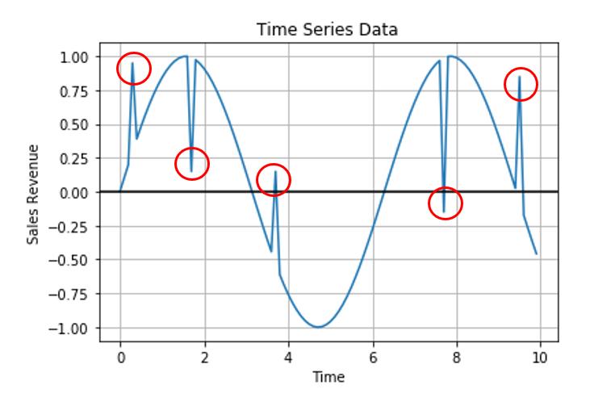
What Is Anomaly?
In time series data, an anomaly or outlier can be termed as a data point which is not following the common collective trend or seasonal or cyclic pattern of the entire data and is significantly distinct from rest of the data.
Why it Is Important?
In order to estimate, regroup and restructure business strategies and decision making process, it is very important to keep track of anomalies in every sector.
From Sales and Marketing, to Supply Chain and Manufacturing, every stage of the business requires sufficient information, especially about these anomalies to shape their process and maximize productivity and outcome.

Slide 4
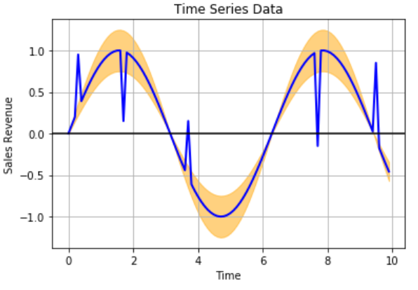
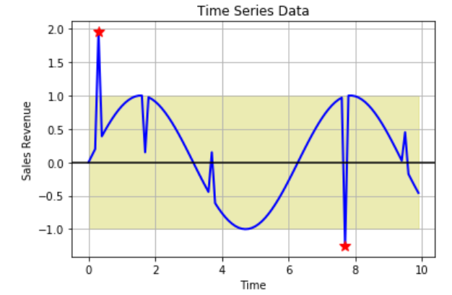
How to do Time Series Anomaly Detection?
By Predictive Confidence Level Approach
One way of doing anomaly detection with time series data is by building a predictive model using the historical data to estimate and get a sense of the overall common trend, seasonal or cyclic pattern of the time series data.
Statistical Profiling Approach.
This can be done by calculating statistical values like mean or median moving average of the historical data and using a standard deviation to come up with a band of statistical values which can define the uppermost bound and the lower most bound and anything falling beyond these ranges can be an anomaly.

Slide 5
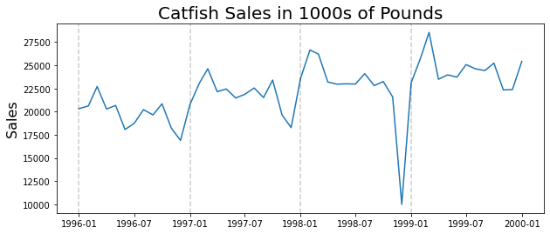
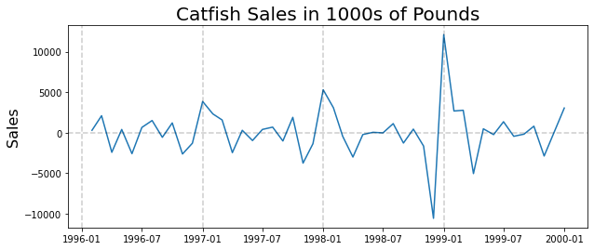
Data Set: It Is a catfish monthly Sales data. From Jan, 1996 to Jan, 2001.
We can See that there is Trend As well AS Seasonality In the Data Set.
Removing The Trend: After Removing the Trend We can See Data is Center Around 0 And There is no Upward or Downward Trend. But we still have the Seasonality

Slide 6
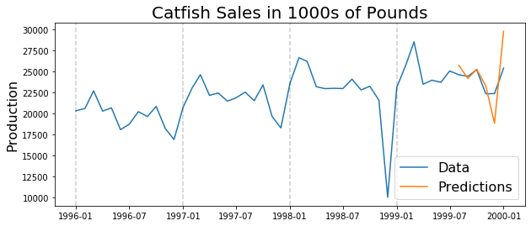
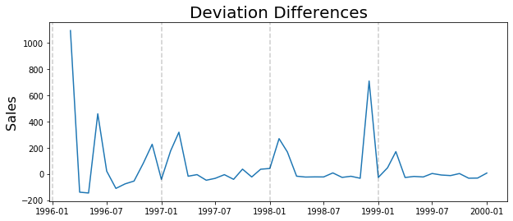
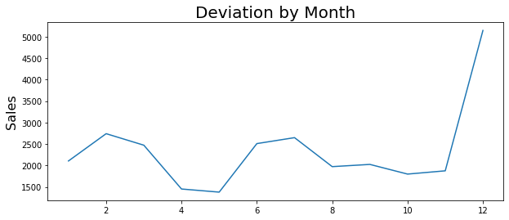
Prediction Without Anomaly Detection: Prediction Is Highly Skewed.
First Couple of months are OK but As soon as we get to the December Time Period It Is highly over predicted. Because It is considering previous Years December Data for Prediction.
And due to this prediction we over correct and predicted next Month Vary High. Hence This will create the problem in future Prediction.
Detecting The Anomaly:
Deviation Method: We will calculate the Std Dev For the Each Window Size.
Seasonal Method: This is used when we know when there is seasonality in our Data. This chart show what is the STD dev when we only consider the data point in the given month.`

Slide 7
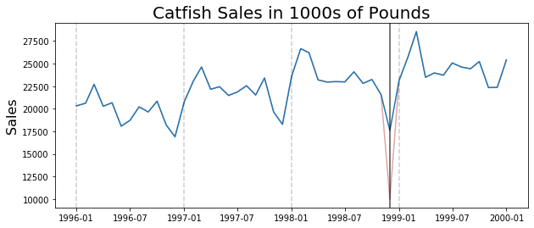
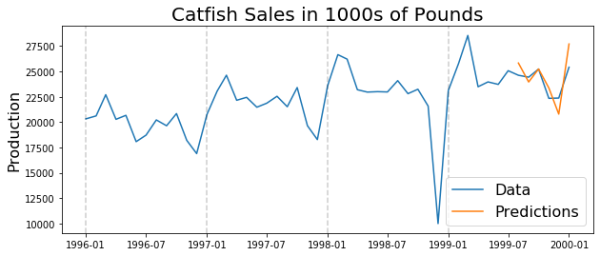
Treating the Anomaly: Now in the Next Step we will find the which December has the anomaly, By collecting all December data and eliminating one December data at a time and Calculate the SD of the Other three December, And the December month which change the SD the Highest contain the Anomaly.
Then We will replace the December containing Anomaly with the Local mean of All other remaining December.
Prediction after Detecting and Treating the Anomalies: We can now see the prediction is much closer to the actual values.
MAPS is reduced to 0.0459 from 0.1061
RMSE is 1321.21 vs 3121.39 before anomaly detection.

Slide 8
Thanks

